Slide 1

A NODE-LEVEL SECURITY ALGORITHM FOR CLOUD ASSISTED - IoT Project Batch - A14
Project Members Project Guide
CH. Lakshmi Prasanna (18JG1A0517) Mr. S. Sumahasan
G. Sireesha Devi (18JG1A0529) Assistant Professor
K. Hanna Shiny (18JG1A0532) CSE Dept.
B. Vasantha (18JG1A0508)
Department of Computer Science and Engineering
GAYATRI VIDYA PARISHAD COLLEGE OF ENGINEERING FOR WOMEN
[Approved by AICTE NEW DELHI, Affiliated to JNTUK Kakinada]
[Accredited by National Board of Accreditation (NBA) for B. Tech. CSE & IT- Valid from 2019-20 to 2021-22]
Madhurawada, Visakhapatnam- 530048
Academic Batch: 2018-2022

Slide 2
CONTENTS
Screenshots
UML Diagrams
Algorithm Flowchart
Advantages
Disadvantages
Conclusion
References
Abstract
Introduction
System Requirements
Existing System
Proposed System
System Architecture
Algorithms
Implementation Modules

Slide 3
ABSTRACT
Medical electronics is also going to advance with the application of IoT, it is the fastest growing Technology. IoT is about finding an application everywhere and in everything. Cloud-assisted Internet of Things (IoT) provides a favorable solution to data booming problems for the ability constraints of individual objects. However, with the influence of cloud, IoT faces new security challenges for data mutuality between two parties, which is novel in this work and have been not currently addressed at the present time by the conventional approaches. This work carries out a systematic inquiry using a secure cloud-assisted IoT data managing method to keep data confidentiality when collecting, storing and accessing IoT data with the help of a cloud with the consideration of regular increase in users. The proposed system applies a node level power aware security algorithm. Hence, a secure IoT under our proposed method could resist most attacks from both insiders and outsiders of IoT to break data confidentiality.

Slide 4
INTRODUCTION
The present security systems provide security to the data after it reaches the cloud.
This may lead to data breaches through any kind of intruder attacks on the way the data is being travelled to reach the cloud from the node.
In the proposed system that we are working, we tried to provide security to the data at the Node-Level itself before sending it to the cloud.

Slide 5
SYSTEM REQUIREMENTS
HARDWARE REQUIREMENTS
→Raspberry Pi3
→Pulse Rate Sensor
→Connecting Wires
→Bread Board
→MCP 3208 (12-bit ADC)
SOFTWARE REQUIREMENTS
→PostgreSQL 12
→Python 3.10.2
→Django 4.0.3
→Firebase

Slide 6
EXISTING SYSTEM
Data is encrypted using various symmetric cryptographic algorithms.
The encryption is performed only at the cloud level.
This can lead to security breaches while uploading the data to the cloud.

Slide 7
PROPOSED SYSTEM
Various asymmetric cryptography algorithm are used to encrypt the data.
The encryption is performed at the node-level to ensure security while uploading data to the cloud.
The proposed system has four modules:
→Designing a heartbeat monitoring system.
→ Providing security at node level.
→ Uploading encrypted data into cloud.
→ Accessing the data through webpage.

Slide 8
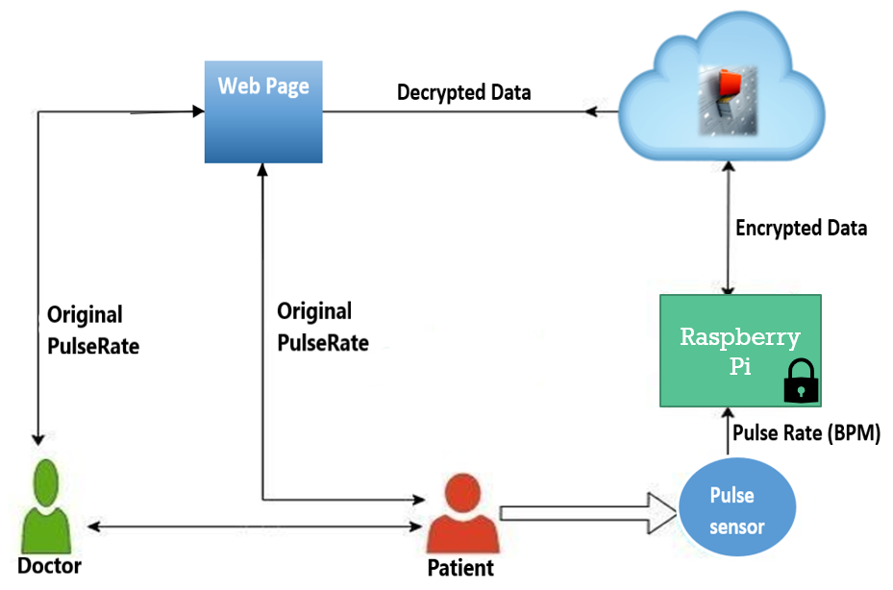
SYSTEM ARCHITECTURE

Slide 9
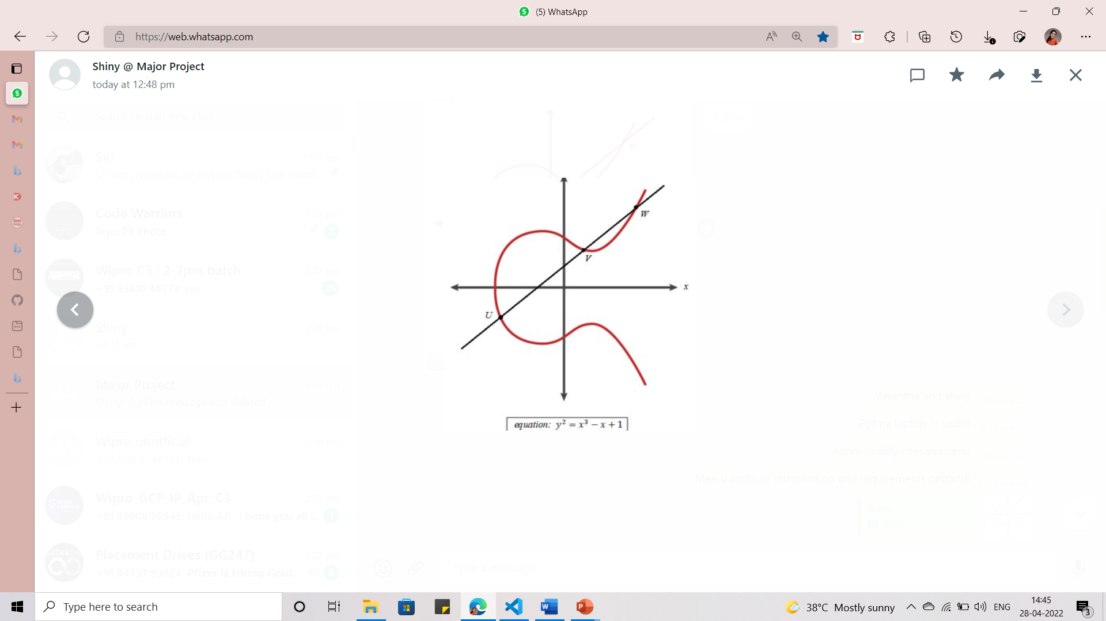
ECC ALGORITHM
Elliptic Curve Cryptography (ECC) is an approach to public-key cryptography based on the algebraic structure of elliptic curves over finite fields.
A trapdoor function is a function that is easy to compute in one direction, yet difficult to compute in the opposite direction (finding its inverse) without special information, called the "trapdoor".
Key generation is an important part where we have to generate both public key and private key. The sender will be encrypting the message with receiver’s public key and the receiver will decrypt using its private key.

Slide 10

EC ELGAMAL ALGORITHM
EC ElGamal is the short form for Elliptic Curve ElGamal which is one of the algorithms present in the elliptic curve cryptosystem.
We often use elliptic curves for public key cryptography tasks such as key exchange and digital signature tasks. Because these curves serve faster implementations than other trusted algorithms such as Diffie Hellman or RSA(Rivest-Shamir-Adleman).
Rarely, we can adapt elliptic curves for symmetric key encryption tasks. This idea is mainly based on ElGamal encryption schema and elliptic curves.
We will create a python implementation of this concept. All points on the elliptic curve can be mapped directly to an ASCII value.
Koblitz represents message as a point or a set of points on an elliptic curve.
${ y}^{2}$ mod p= ${ x}^{3}$+ $ax$+b mod p

Slide 11

MESSAGE ENCODING ALGORITHM
Divide the message into blocks of fixed size.
Express each block as a number x.
This converts the message into a series of numbers between 0 and 35.
α=${ x}^{3}+ax+b$mod p
Γ=$a^{(p−1)}$/2
If Γ ≠11 then set $x$=$x$+1
b=$√(α mod p)$
y=b

Slide 12
Public key generation
We can produce our public key. Public key would be independent from plaintext. We will pick a secret key and calculate secret key times base point. That would be our public key.
Encryption
c1= Generator point * Private key of node
c2 = (public key of node)*(private key of node)+pm
Decryption
ElGamal decryption scheme is based on the following equation.
decryption = c2 – secretKey * c1
We will adapt this equation into elliptic curves. We have already known how to add points over elliptic curves but the term in the above includes subtraction. Reflecting the sign to multiplier point handles subtraction.
decryption = c2 + secretKey * (-c1)

Slide 13
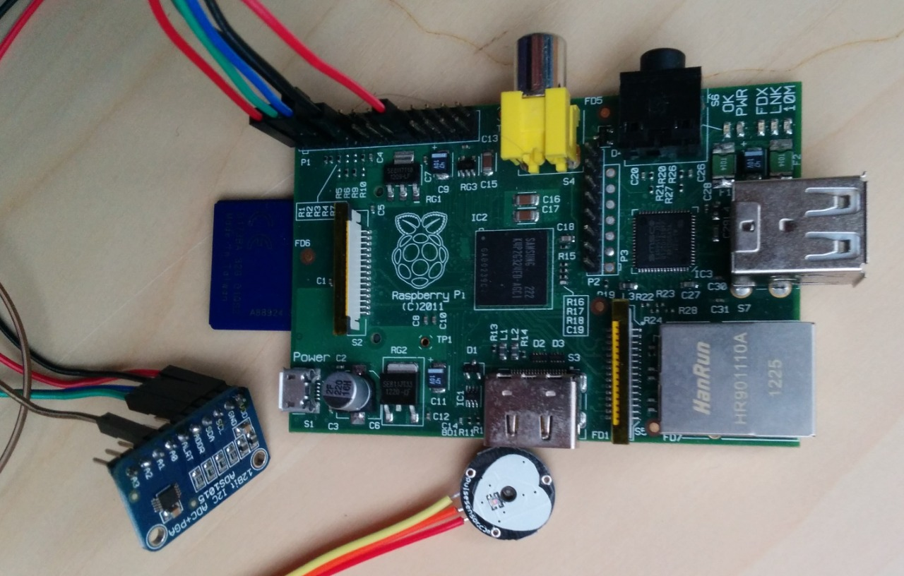
DESIGNING A HEART BEAT MONITORING SYSTEM
The pulse rate sensor is connected to the Raspberry Pi.
The sensor is connected to the GPIO (General Purpose Input/Output) pins through the ADC(Analog to Digital Converter).
The patient’s heart rate is measured using the pulse sensor.

Slide 14
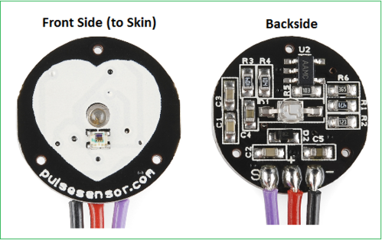
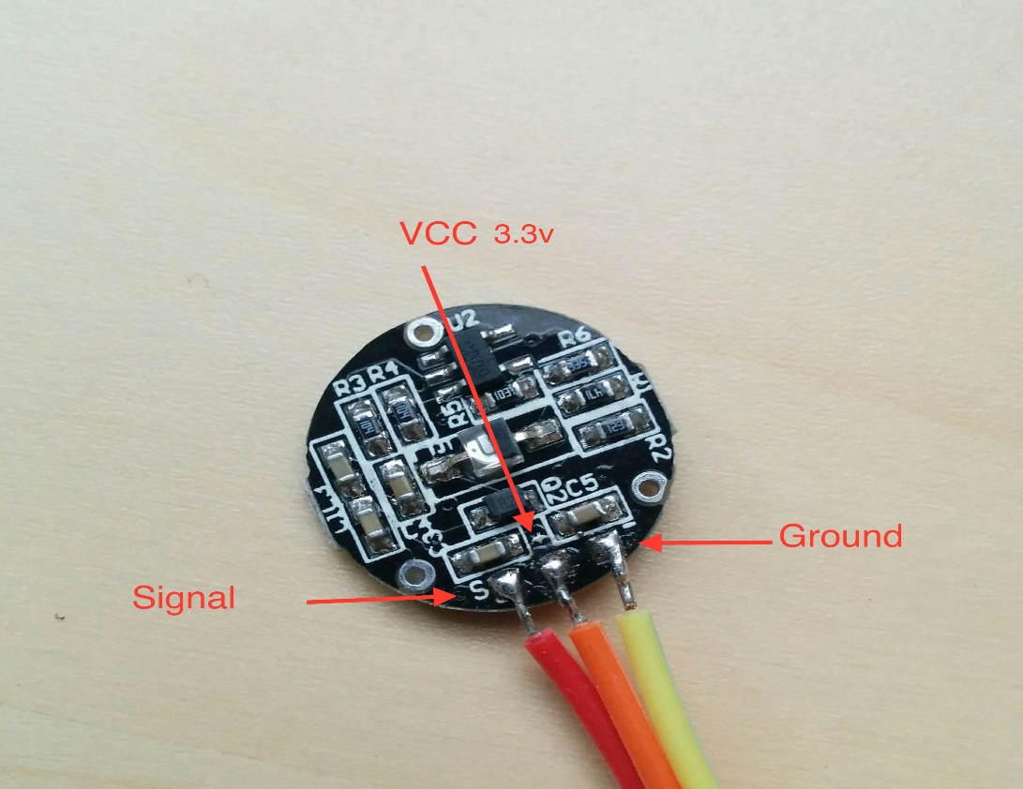
PULSE SENSOR

Slide 15
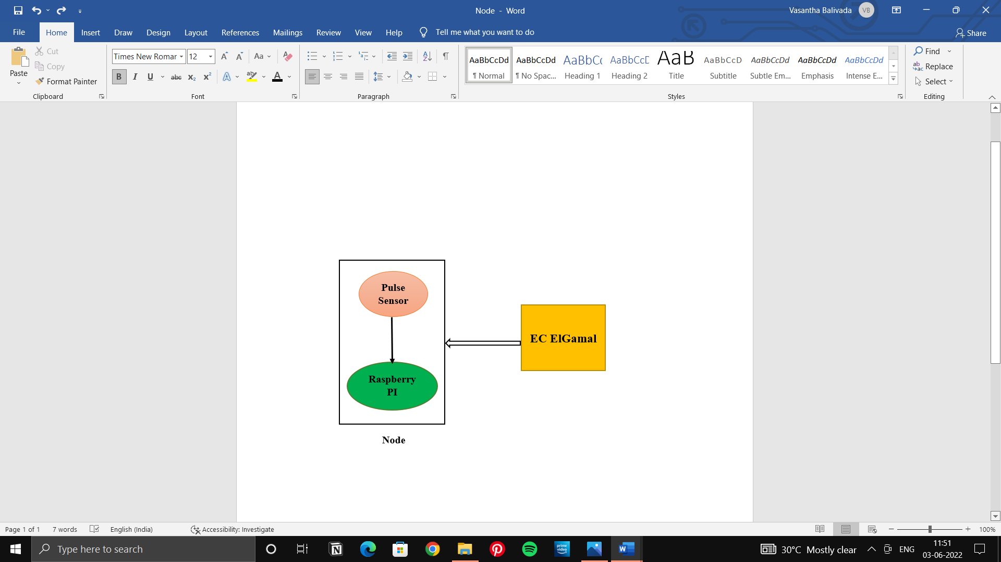
PROVIDING SECURITY AT NODE-LEVEL
The EC ElGamal Algorithm is implemented at the node level which encrypts the data of the patient.
This provides security to the patient’s data and prevents man in the middle attack.

Slide 16
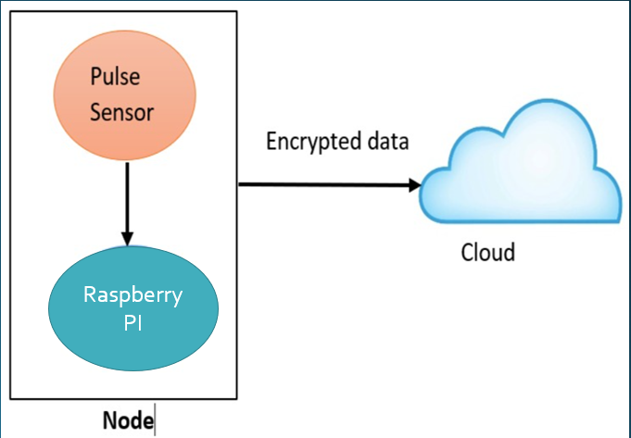
UPLOADING DATA TO THE CLOUD PLATFORM
Here, the data is in encrypted form.
This encrypted data is stored in a cloud.
Firebase is used as the cloud storage to store the encrypted files.

Slide 17
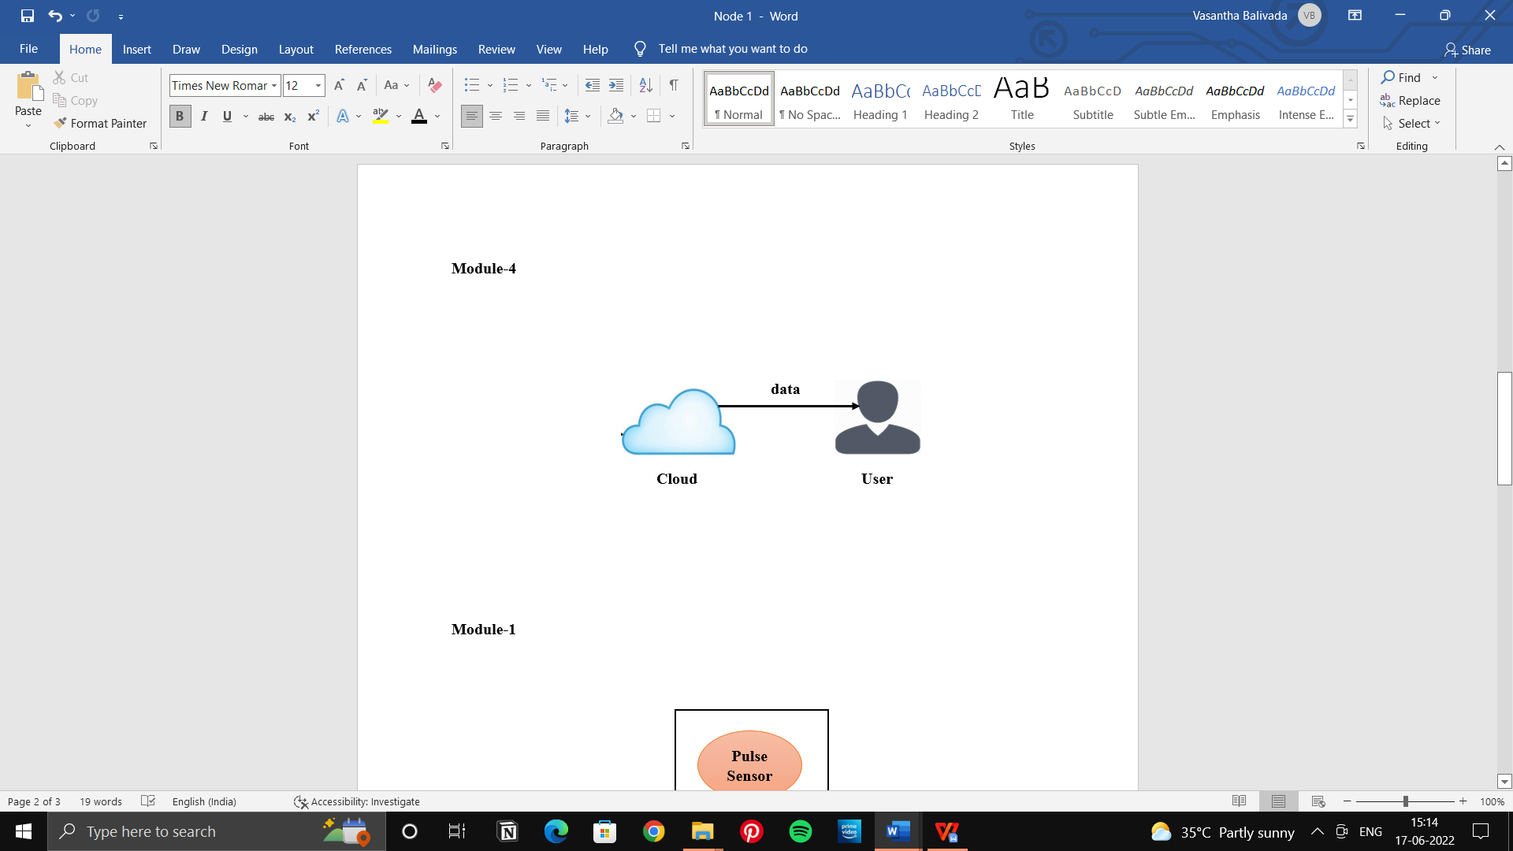
ACCESSING THE DATA THROUGH WEBPAGE
The end-user(doctor or relatives of patient) can access the information of the patient.
Initially, the end-user sends request to the super user or admin to view the data.
The patient’s file can be viewed only after the request is approved.
The end-user generates the secret key from public key to view the decrypted file.

Slide 18
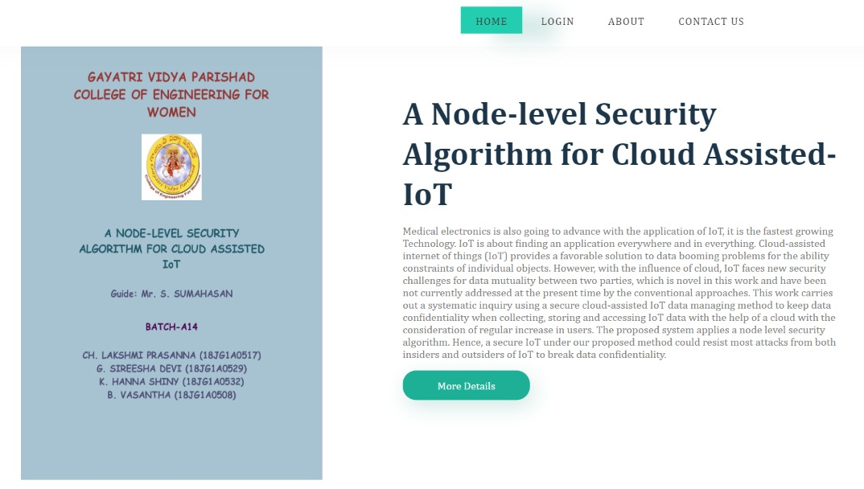
HOMEPAGE

Slide 19
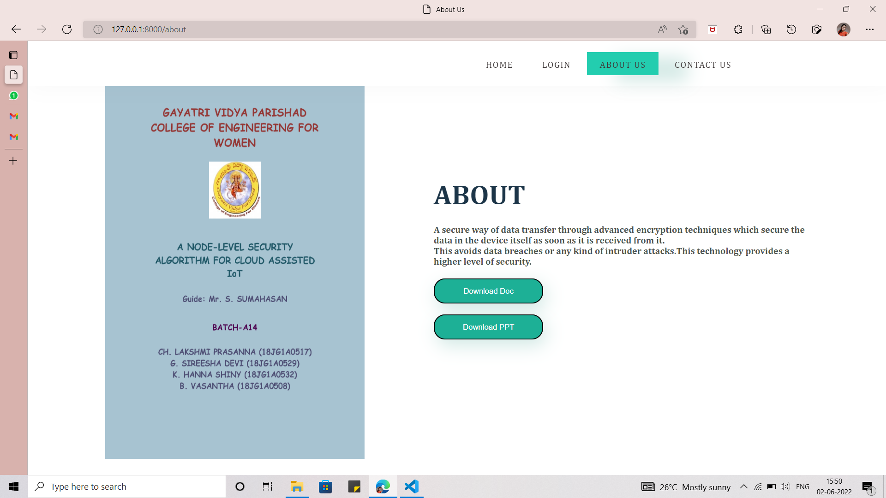
ABOUT PAGE

Slide 20
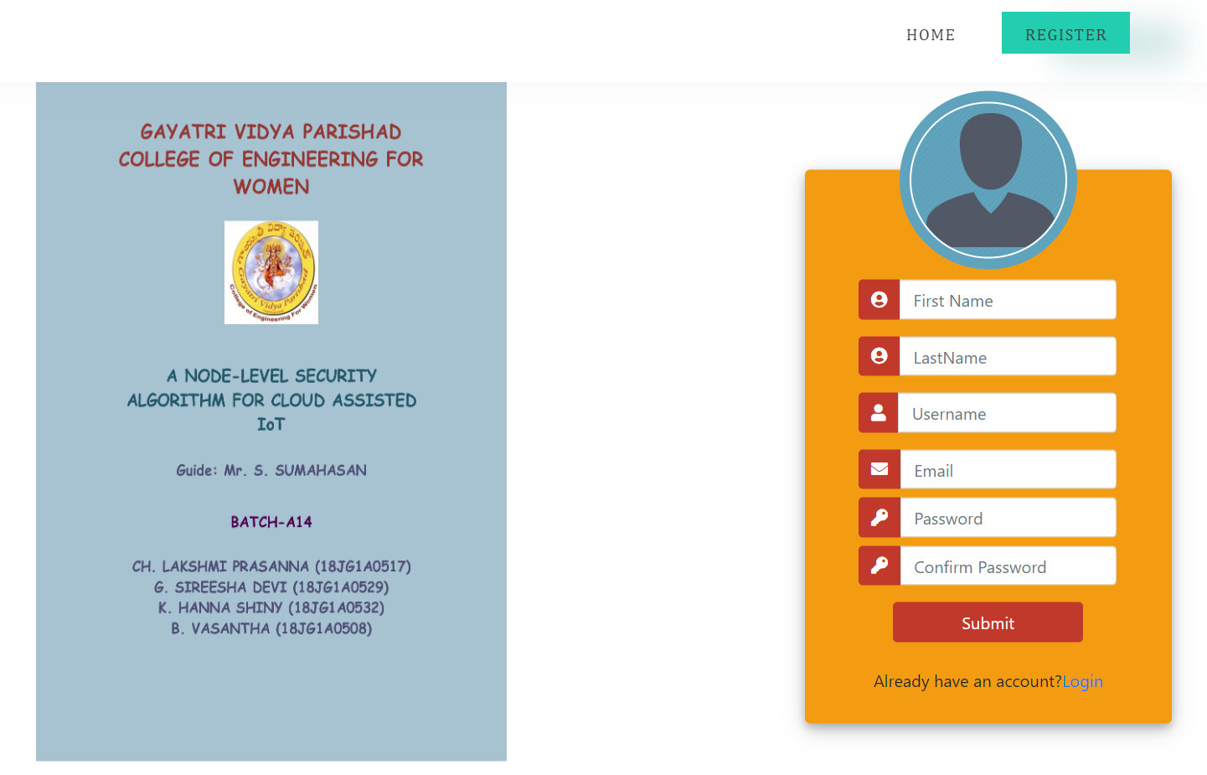
REGISTRATION

Slide 21
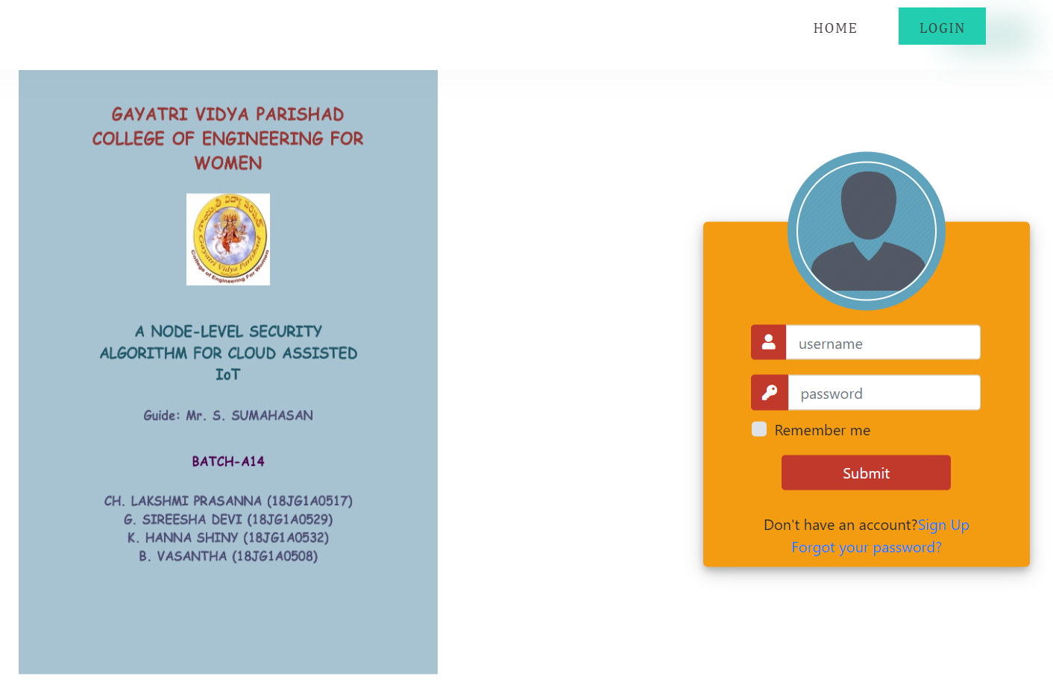
LOGIN

Slide 22
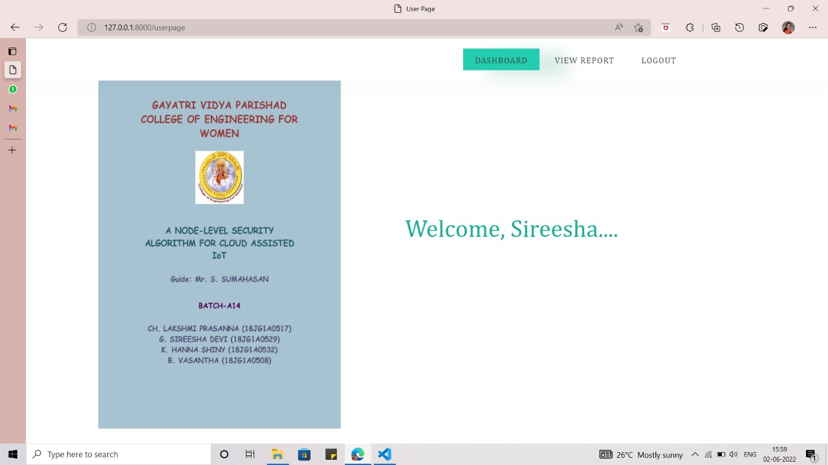
USER PAGE

Slide 23
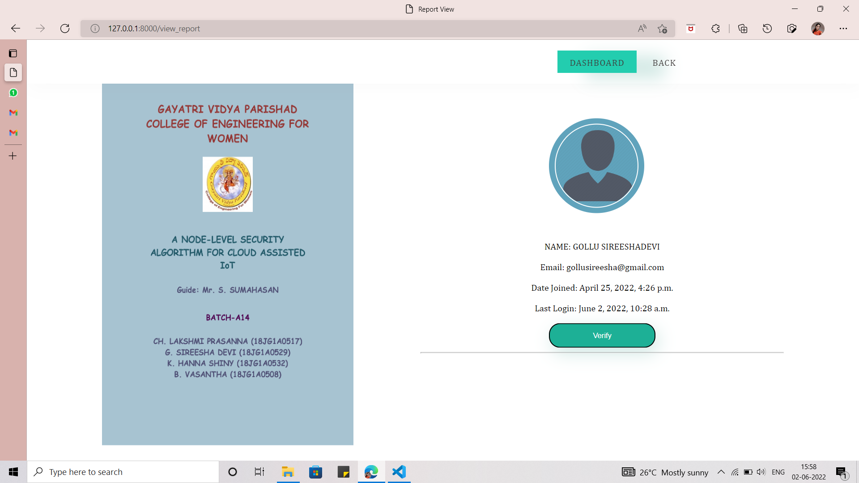
USER DASHBOARD

Slide 24
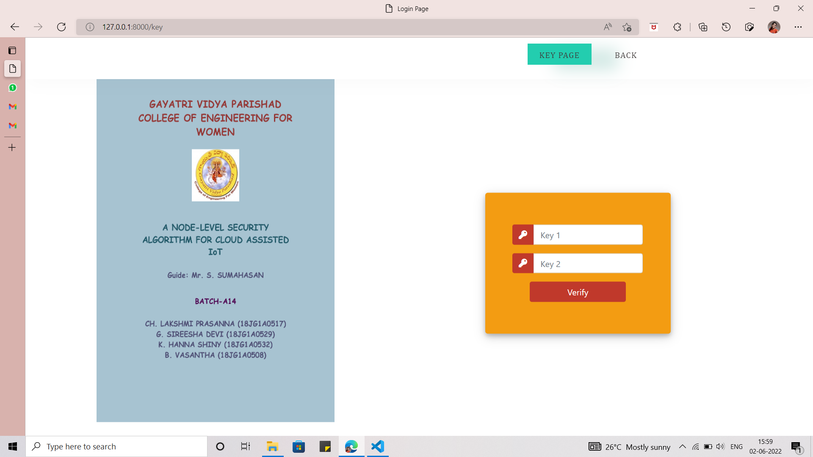
KEY PAGE

Slide 25
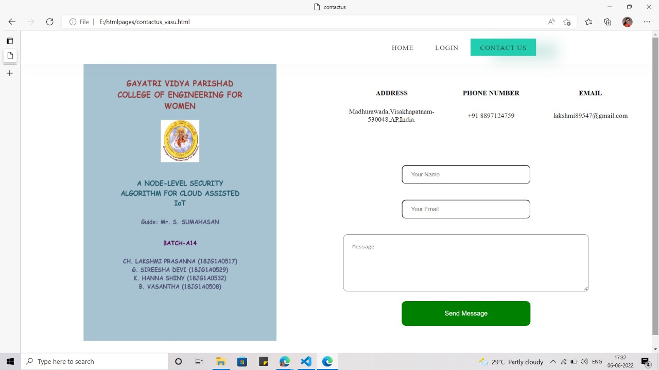
CONTACT US PAGE

Slide 26
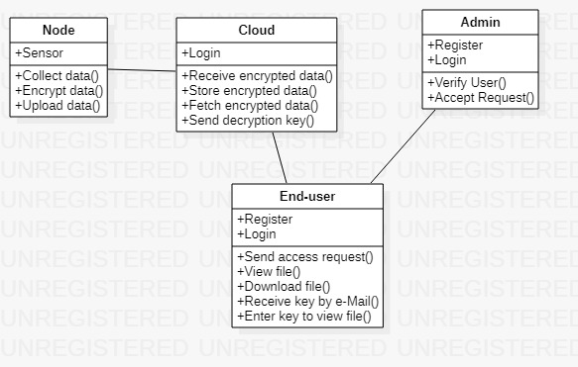
CLASS DIAGRAM

Slide 27
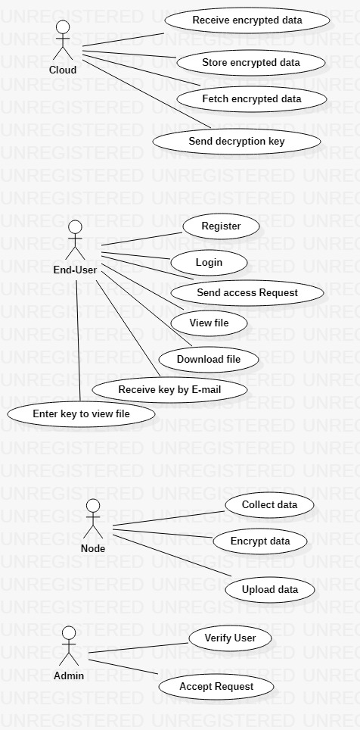
USECASE DIAGRAM

Slide 28
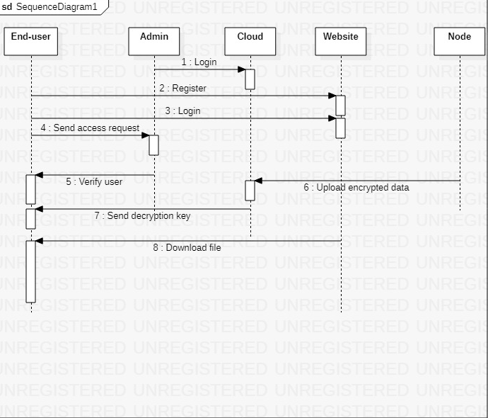
SEQUENCE DIAGRAM

Slide 29
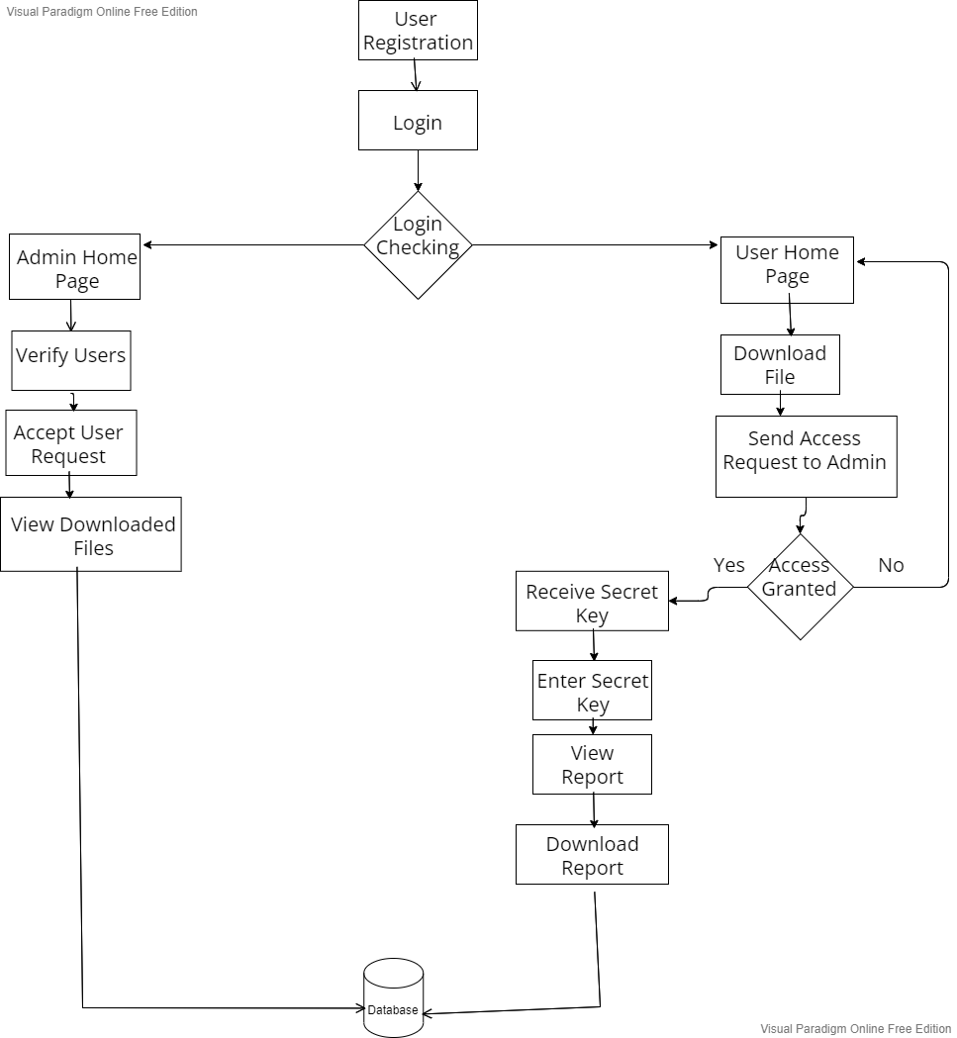
ALGORITHM FLOWCHART

Slide 30
ADVANTAGES
The algorithms that are used provide high level security to the data.
There will be no chance for the attacker to steal and alter the data.
Raspberry Pi provides more storage space to store maximum data.

Slide 31
DISADVANTAGES
Raspberry Pi has high power consumption.
The pulse sensor may sometimes produce inaccurate results as it is in contact with the skin.

Slide 32
CONCLUSION
The numerous benefits provided by encryption have driven many large multi-level organizations to transfer their data based on it. This project begins by pointing out major security concerns data owners have when sharing their data on the cloud. Next, the most widely implemented and researched data sharing schemes are briefly discussed revealing points of weakness in each. To address the concerns, this project proposes a way in which data can be transferred in a secure way without any data breaches. For securing the data we use certain encryption algorithms like Elliptic-Curve Algorithm (ECC), Elliptic-Curve Diffie Hellman Algorithm (ECDH) which produce a public and a private key to produce an encrypted format of the original text to be transferred. Our comprehensive encryption algorithms provide data security and avoid data breaches from any kind of intruder attacks.

Slide 33
REFERNCES
Skarmeta A., Moreno M.V. (2014) Internet of Things. In: Jonker W., Petković M. (eds) Secure Data Management. SDM 2013. Lecture Notes in Computer Science, vol 8425. Springer, Cham. https://doi.org/10.1007/978-3-319-06811-4_10
J. A. Stankovic, "Research Directions for the Internet of Things," in IEEE Internet of Things Journal, vol. 1, no. 1, pp. 3-9, Feb. 2014, doi: 10.1109/JIOT.2014.2312291.
Akpinar, Kutalmis, Kien A. Hua and Kai Li. “ThingStore: a platform for internet-of-things application development and deployment.” Proceedings of the 9th ACM International Conference on Distributed Event-Based Systems (2015): n. pag.
Y. Li, W. Dai, Z. Ming and M. Qiu, "Privacy Protection for Preventing Data Over-Collection in Smart City," in IEEE Transactions on Computers, vol. 65, no. 5, pp. 1339-1350, 1 May 2016, doi: 10.1109/TC.2015.2470247.
V. S. Mahalle and A. K. Shahade, "Enhancing the data security in Cloud by implementing hybrid (Rsa & Aes) encryption algorithm," 2014 International Conference on Power, Automation and Communication (INPAC), 2014, pp. 146-149, doi: 10.1109/INPAC.2014.6981152.
M. Frustaci, P. Pace, G. Aloi and G. Fortino, "Evaluating Critical Security Issues of the IoT World: Present and Future Challenges," in IEEE Internet of Things Journal, vol. 5, no. 4, pp. 2483-2495, Aug. 2018, doi: 10.1109/JIOT.2017.2767291.

Slide 34
THANK YOU

